Slide 1
BTEC Extended Certificate in Sport
Sixth Form Taster Day
Tue 24th June

Slide 2


The course
Pearson BTEC Level 3 National Certificate in Sport
360 Guided Learning Hours
9 lessons over a fortnight (11 PE lessons inc Core PE)
Equivalent to 1 A LEVEL
4 units
  3 are mandatory and 2 external

Slide 3
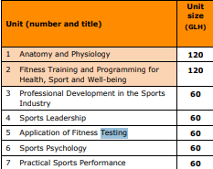

The course
A broad basis of study for the sport sector
It is the ultimate subject combining Psychology, Biology, Physics, through the lens of sport and physical activity

Slide 4
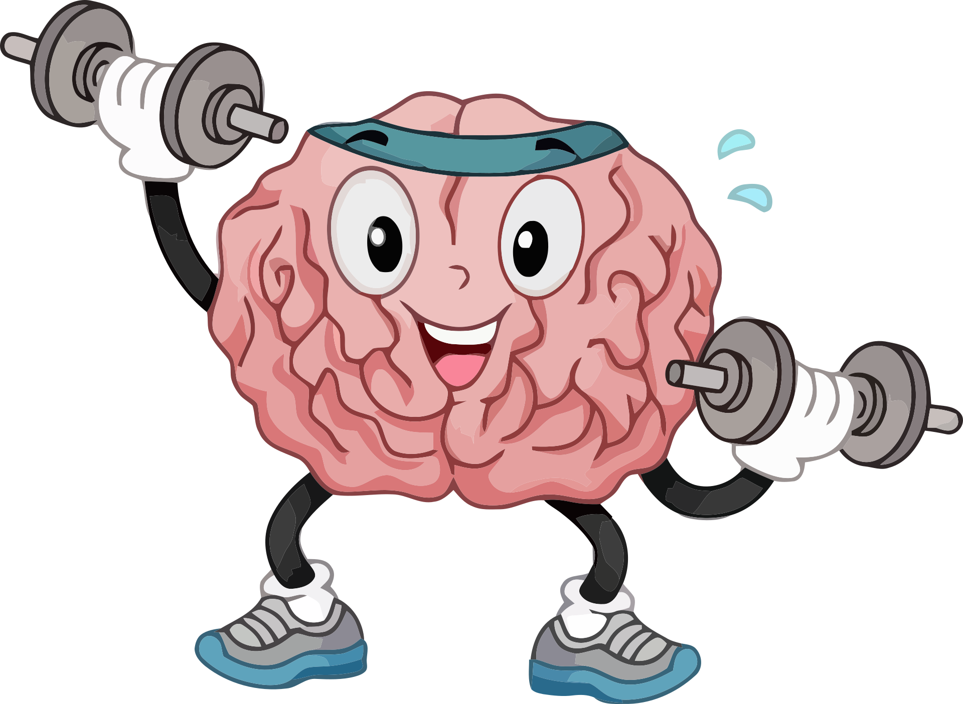
Why you would choose Sport!
This qualification is designed to support progression to higher education
If you have dreams for becoming the following
  Sports coach, Physical Trainer, Physiotherapist, Exercise rehabilitation, Sports Psychologist or PE TEACHER!!!!!!!
If you have an interest in how the human body work in relation to physical activity
If you wish to further understand you own body and how to maximise your own sporting performance

Slide 5
Why should you choose Sport!
A mix and practical and theoretical lessons,
  Applying what you learn in class to practical scenarios
Encourages teamwork, leadership, time management, and communication — all vital in the sports industry and beyond.
Notes:
Students often perform better when they can apply what they’ve learned through projects, presentations, and group activities.

Slide 6
More information
https://qualifications.pearson.com/en/qualifications/btec-nationals/sport-2016.html

