Slide 1

What is physics?

Slide 2
Why did you do physics?

Slide 3
What can physics do for you?

Slide 4
SI units (SystÈme international)
Quantity | Unit | Abbreviation
Mass | kilogram | kg
Length | metre | m
Time | second | s
Temperature | kelvin | K
Electrical current | ampere | A
Amount of substance | mole | mol

Slide 5
SI prefixes
Prefix | Name | Abbreviation
10⁻¹² | pico | p
10⁻⁹ | nano | n
10⁻⁶ | micro | μ
10⁻³ | milli | m
10⁻² | centi | c
10³ | kilo | k
10⁶ | mega | M
10⁹ | giga | G
10¹² | tera | T

Slide 6
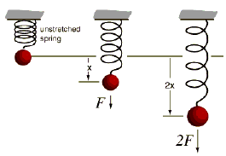
Making sure that the forces are okay.
Can you use the apparatus here to calibrate the spring so that you can use only it and a ruler to find the mass of a mystery object?
This is to do with something called Hooke’s law. If you put a mass on a spring it will always go down by the same amount each time. Can you use this fact to do an experiment to find the mass of a mystery object?

Slide 7
Springs
What does this mean?
F=-k x

Slide 8
Force-Extension Graph for a spring
Force/N
The “elastic limit”
The “limit of proportionality”
Hooke’s Law:
F=-kΔx
What is the spring constant for this spring?
Hooke’s Law is obeyed here – “elasticity”
Extension/mm

Slide 9

Experiment time
I want you to make a graph to prove Hooke’s law

Slide 10
Experiment time
What is the mass of this mystery object?

Slide 11

Present your findings

Slide 12
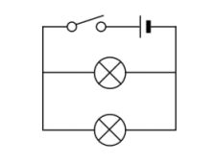
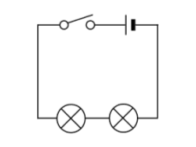
What type of circuit to use?
Planes have a range of different circuits in them. But which ones are best to use in the lights.
Try these two different types of circuit and then decide.
Remember that science is about the WHY, so explain WHY you have chosen that type of circuit

