Slide 1
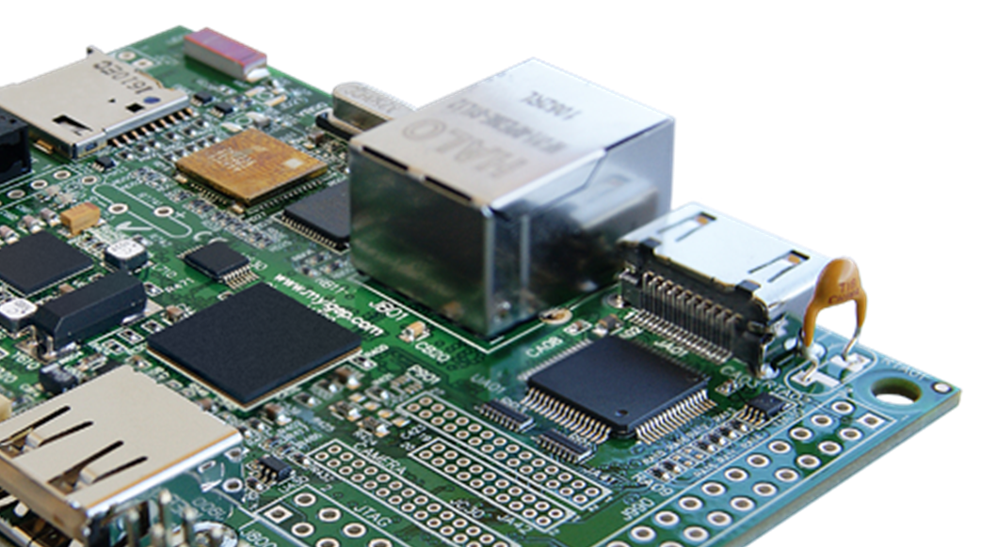
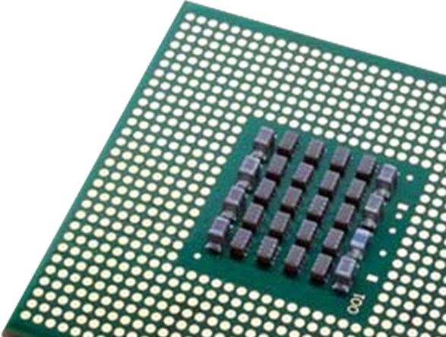
“Computer Science is no more about computers than astronomy is about telescopes.” - Edsger W. Dijkstra

Slide 2

When someone says,
“Computer Science” what do you think of?

Slide 3


Slide 4

Why choose Computer Science?
Technology is embedded in every aspect of our lives.
Computer Science is being used help solve many of the world's biggest problems

Slide 5


Slide 6
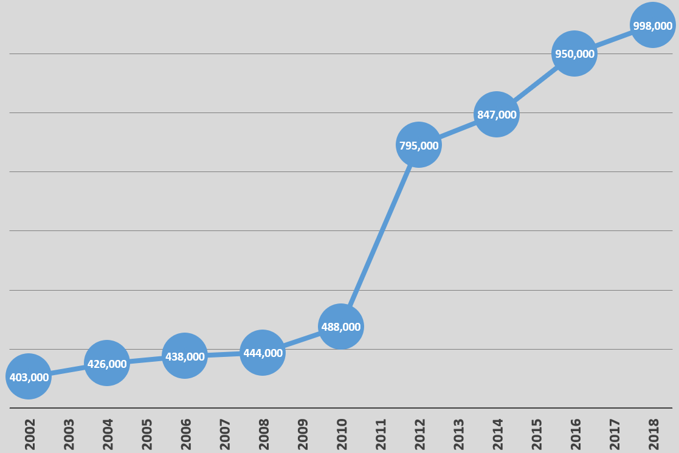

Growth in IT professional and Computing jobs in the UK
(Data from Office for National Statistics: https://www.ons.gov.uk)
Growth in this sector is predicted to continue to grow!
Did you know the computer games industry is bigger than the film and music industries combined?

Slide 7

Skills in Computer Science can offer you an incredible wide range of jobs!
There are almost no job sectors which don’t make use of skills related to:
- Information Technology
- Computer Science

Slide 8


Slide 9

What does the course cover?
Internal computer components
Cyber security
Data representation
Effect of digital technology on society
Programming
Networking and the Internet
Software development

Slide 10
AQA AS level course structure
 | Paper 1: | Paper 2:
How is it assessed | On-screen exam 1 hour 45 minutes | Written exam 1 hour 45 minutes
How much is it worth | 75 marks Worth 50% | 75 marks Worth 50%
Other information | Students answer a series of short questions and write/adapt/extend programs in an electronic answer document provided by AQA. | A series of short-answer and extended-answer questions.

Slide 11
AQA A level course structure
 | Paper 1: | Paper 2: | Practical programming experience
How is it assessed | On-screen exam 2 hour 30 minutes | Written exam 2 hour 30 minutes | Marked by your teacher and moderated by AQA.
How much is it worth | 100 marks Worth 40% | 100 marks Worth 40% | 75 marks Worth 20%
Other information | Students answer a series of short questions and write/adapt/extend programs in an electronic answer document provided by AQA. | Compulsory short-answer and extended-answer questions. | Assesses student's ability to use the knowledge and skills gained through the course to solve or investigate a practical problem.

Slide 12
OCR AS level course structure
 | Component 1: Computer systems | Component 2: Computational thinking, algorithms and programming
How is it assessed | Written exam 1 hour 15 minutes | Written exam 1 hour 15 minutes
How much is it worth | 70 marks Worth 50% | 70 marks Worth 50%
Other information | A series of short-answer and extended-answer questions. | A series of short-answer and extended-answer questions.

Slide 13
OCR AS level course structure
 | Component 1: Computer systems | Component 2: Computational thinking, algorithms and programming | Practical programming experience
How is it assessed | Written exam 2 hour 30 minutes | Written exam 2 hour 30 minutes | Marked by your teacher and moderated by OCR.
How much is it worth | 140 marks Worth 40% | 140 marks Worth 40% | 70 marks Worth 20%
Other information | A series of short-answer and extended-answer questions. | A series of short-answer and extended-answer questions. | Assesses student's ability to use the knowledge and skills gained through the course to solve or investigate a practical problem.

Slide 14

Where to get more information
<insert details of subject teacher / head of department here>
AQA Exam board website:
aqa.org.uk

Slide 15
Where to get more information
<insert details of subject teacher / head of department here>
OCR Exam board website:
ocr.org.uk

