Slide 1


A Level expectations
Create a better future

Slide 2
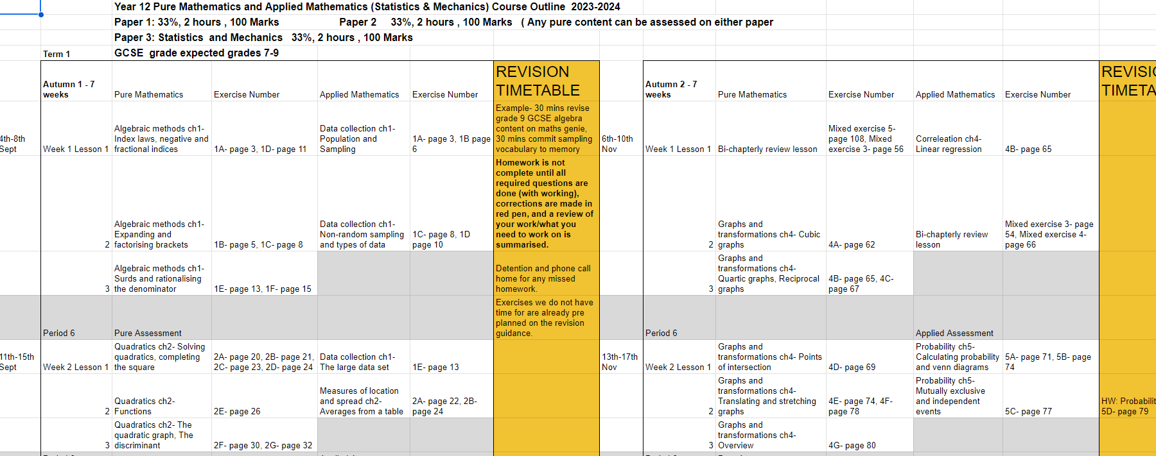

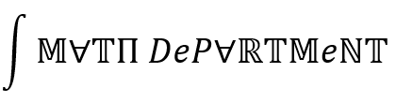
Course outline:
Title
00-00-00
Tracking your work
It will be a lot
The course is very fast
As and A2 topics covered

Slide 3
Discipline
Title
00-00-00
The difference between A level and GCSE
Once you have discipline you can achieve anything
What it takes to be disciplined
Hard work and consistency leads to many benefits
Transferable to other aspects of life → take this structure and me holding you accountable now as a gift
(even if it doesn’t feel like one)

Slide 4
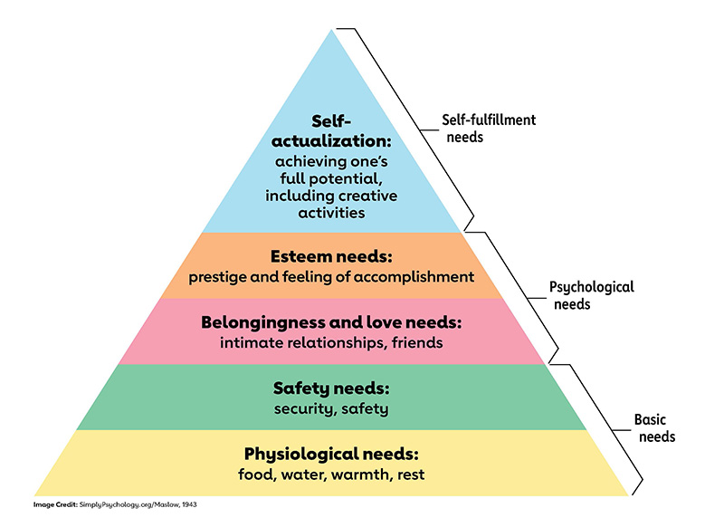
Maslow’s Hierarchy of Needs
Title
00-00-00
Notes:
This slide or slide’s will serve as the exposition section of the lesson. This can comprise of any visual or written explanations required for the learning objectives to be met.
A great place to find good examples and inspiration of explanations is at:
White Rose: https://whiterosemaths.com/
Median by Don Stewart: https://donsteward.blogspot.com/
BossMaths: https://www.bossmaths.com/
Khan Academy: https://www.khanacademy.org/
Oak Academy: https://www.thenational.academy/

Slide 5
Purposeful teaching
Title
00-00-00
Everything about this course is a result of conscious and informed decisions that were made
Most decisions I will explain and only for time reasons it's not all. I believe that my job is not just to teach you maths
As a student, being open and receptive towards the course will benefit you most
I do take ideas though!
Growth mindset: hiding from what you don't know is fatal on this course

Slide 6
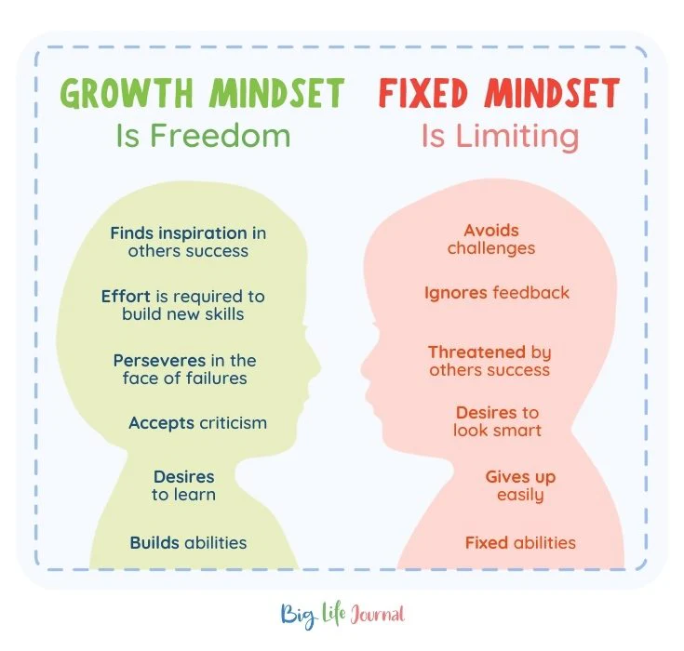
Growth Mindset
Title
00-00-00
If you knew everything you wouldn’t even be here!
I expect you to get things wrong

Slide 7
The 1st half of Y12
Title
00-00-00
Much like GCSE
Less new content
Develop mathematical maturity and fluency
Need to become rigorous and precise

Slide 8

P6 lessons
Title
00-00-00
One additional lesson a week (for free wow!)
It will be a 30 minute assessment
Self marked and discussion for 30 minutes
Benefits: you know exactly what you know and what you don't every week, become more self reliant mathematicians, strengthen your mathematical argumentation with other students, build a culture of seeing mistakes as secret opportunities that reveal the mathematical structure, be more confident in university like settings (seminars and interviews)
Cons: you get to do more maths with me! (Oh wait that's another positive)
Notes:
A great place to find resources of variety of questions can be found at:
Resourceaholic: https://www.resourceaholic.com/
White Rose: https://whiterosemaths.com/
Median by Don Stewart: https://donsteward.blogspot.com/
BossMaths: https://www.bossmaths.com/
CorbettMaths: https://corbettmaths.com/
DrFrostMaths: https://www.drfrostmaths.com/index.php
Variety Theory By Craig Barton: https://variationtheory.com/

