Slide 1

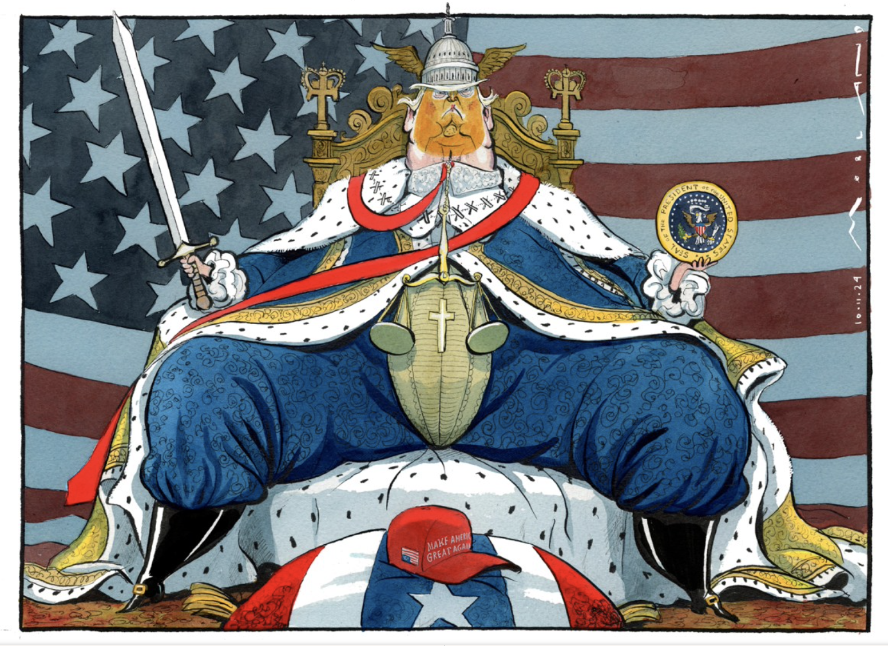
We are studying the signals and references that cartoonists make in their cartoons. .
Study the source. Annotate all of the things you notice.
Link the points to the big stories on the right of the page
Add extra detail to connect the source to the story
Sum up the message of the source in the right column. Make sure you link the source and the underlying stories together.
When assessing the cartoon think about
Imagery used
Specific references
Links to what is happening at the time
Story Behind the Cartoon
Trump’s personality
Trump’s image
The Supreme Court
Winner of the 2024 Presidential election
Supporters
Congress
The Office of President
American Patriotism
The Constitution
Social Media
Monarchy
The Message of the source.
Source A: Morten Morland, The Sunday Times November 10, 2024

