Slide 1
Enter 7 bits into the box below. Is your bit pattern correct or not?
7-bit data stream | Correct? |  | 7-bit data stream | Correct?
Notes:
A logical thinking puzzle that is deceptively hard for students because it is so easy!! This needs to be led from the front.
Ask a student to write a 7-bit binary sequence on the board.
Ask someone else in the class whether they think this is a correct or an incorrect sequence.
DO NOT share with the class that this is an illustration of odd parity. If the number of 1s in the sequence is even, it is incorrect. If the number of 1s is odd, it is correct.
You mark with a tick or a cross whether it is correct on the board.
Challenge the students to work out what is going on without giving the game away.
Ask the next student to write a sequence on the board and continue…
If a student thinks they know what is happening, tell them to keep it to themselves and test their theory is correct when other sequences are added to the board.
You can throw students off the scent by pretending to take a while to work it out and suggesting maybe it has something to do with binary numbers.
Eventually students will work it out and you can reveal this algorithm is known as odd parity.

Slide 2

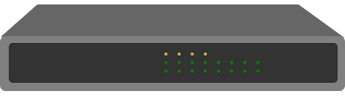
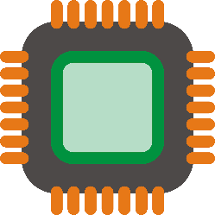
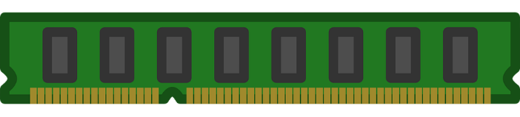
THE KEY QUESTION
How can errors be detected and corrected when data is transferred between devices?
Input device to PC
with USB.
CPU to RAM
with a systems bus.
Router to router
with fibre optic cables.
Notes:
Explain that error detection is necessary in all computer systems. Examples include:
Inputs to and from peripherals.
Data transfers between internal components on the motherboard.
Networking, both local and wide area networks such as the internet.

Slide 3
THE KEY QUESTION
How can errors be detected and corrected when data is transferred between devices?
There is an assumption that data transfer is always reliable and accurate.
This is not the case.
All data in a computer system is in binary. It is easy for a bit to be misread by a receiving device as a 0 or 1.
Notes:
To share with students…

Slide 4
Why do errors occur in data transmission?
Source of Error | What Causes It
Line outages | Storms, accidents and animals!
Noise | Random electron movement.
Cross-talk | Using adjacent wireless channels. Cables not adequately shielded.
Echo | Poor connections.
Attenuation | Gradual decrease in signal over distance.
Intermodulation | Signals from several circuits combine.
Jitter | Sender and receiver clocks are not perfectly synchronised.
Harmonic distortion | Distortion of a signal.
HAVE A GO
DISCUSSION:
Research the reasons for data communication errors
Notes:
Students spend 5 minutes on the web trying to find reasons for data communication errors.
Can they distil the information they find into something that is easy to explain?
Discuss their findings and the examples given on this slide.

Slide 5
Parity is one method of error detection. With odd parity the binary sequence to be transmitted must contain an odd number of 1’s. Either a 0 or a 1 is added to the end of the sequence to ensure this is the case.
How do I know this data is correct?
Sent 01101101
Received 00101101
Memory controller:
HAVE A GO
DISCUSSION:
How does parity work?
DISCUSSION:
What do we do when an error is detected?
DISCUSSION:
Is there an obvious issue with parity?
Notes:
Explain how odd parity works. If the number of bits is not odd, an error must have occurred.
When an error is detected, the data needs to be resent.
If two bits change then parity doesn’t work. Also, what if there is an error in the message back to the CPU?

Slide 6
Parity can be self-correcting. Consider the binary stream: 1101001100100111. It is possible to not only detect the error, but also correct the error without it being re-transmitted.
1 | 1 | 0 | 1
0 | 0 | 1 | 1
0 | 0 | 1 | 0
0 | 1 | 1 | 1
Even?
Even?
Notes:
Self-correcting parity solves the problem. Show how it is possible to know where an error has occurred if the data is arranged into a grid with parity bits both horizontally and vertically.
If it is known which bit is incorrect, then it can simply be changed instead of requesting the data again.

Slide 7
Show why the data stream 0111 0100 1011 0111 can be received as
1101 0100 0001 0111 and still not be detected as corrupt.
HAVE A GO
DISCUSSION:
In what situation does this algorithm fail?
1 | 1 | 0 | 1
0 | 0 | 0 | 0
0 | 0 | 0 | 1
0 | 1 | 1 | 1
Notes:
If two or more bits change, we know that an error has occurred, but not where. In this case we may need to resend the data.
If the 4 bits in each corner change then an error will not be detected. This is a serious problem for the self-correcting algorithm but happens too infrequently to be a concern. Probably fine for non-critical systems.

Slide 8
Find out what alternatives exist to parity. Explore: echo back and checksums.
Can you explain how these work and any disadvantages with them?
HAVE A GO
DISCUSSION:
Which do you think is the most effective algorithm, parity, echo back or checksums and therefore the one used by routers today?
Notes:
Ask students to find out about alternative algorithms. If there are sufficient numbers in the class, you could do this as a group activity with each group exploring a different technique. You could provide them with some brief notes if additional scaffolding is necessary.
Students to explain to the rest of the class how the algorithm works, with an example using binary.
Note, students can make up a checksum algorithm, they don’t need to use a standard one.
Cyclic redundancy checks (self correcting checksums) are used by devices communicating today. As they use more than one bit for error checking they are more reliable than parity. Echo back is too much of a strain on bandwidth and doesn’t self correct. It has potential to generate more errors as the data transfer is doubled!

Slide 9
THE KEY QUESTION
How can errors be detected and corrected when data is transferred between devices?
Input device to PC
with USB.
CPU to RAM
with a systems bus.
Router to router
with fibre optic cables.
Notes:
Summarise the learning points.

