Slide 1
Psychopathology: Identifying Depression
L/O’s:
To define the term depression from a clinical perspective
To know the difference between sadness and depression
To identify the symptoms of depression
To begin to know the different types of depression
Starter:
When you hear the word depression what comes to mind?

Slide 2
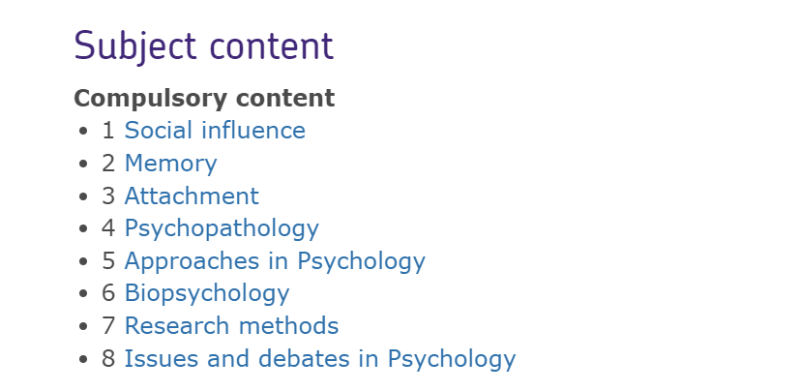

Slide 3
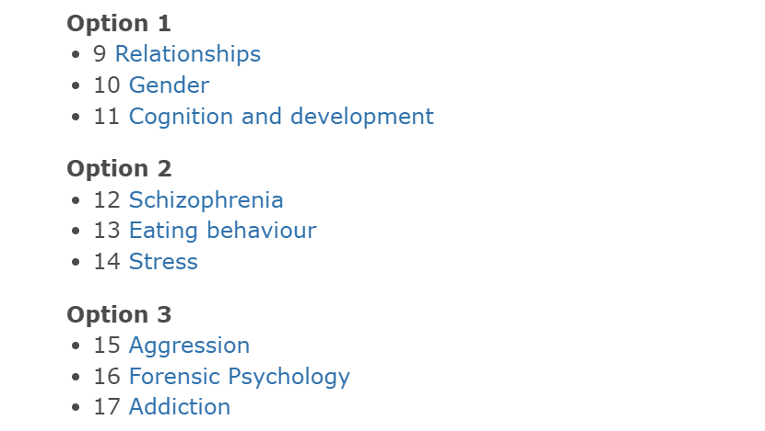
We do :
Relationships
Schizophrenia
Forensic psychology or addiction

Slide 4
Key words
Unipolar depression
Sadness
Depression
Sleep pattern
Bipolar depression
Negative thoughts
Low mood
Suicidal thoughts
Mood disorder
Lack of energy
Appetite levels
Clinical
Reduced concentration
Cognitive
Manic episode
Symptoms

Slide 5
Depression
Depression is a category of mood disorders
Unipolar depression
Key word in this definition is Mood
WHY?
There are two types of depression
Bipolar depression

Slide 6
Task One – Group Activity
On your tables are different symptoms people experience
In groups discuss which symptoms are sadness and which are depression
Stretch and challenge
Explain why a person suffering from any of the symptoms that are linked to sadness may assume they have depression
5-8 MINS

Slide 7
These are all linked to depression and sadness
Continuous low mood or sadness
Feeling tearful
Disturbed sleep
Feeling guilt-ridden
Feeling anxious or worried
Feeling irritable and intolerant of others
Feeling hopeless and helpless
Having no motivation or interest in things
Lack of energy
Having low self-esteem
Finding it difficult to make decisions
Low sex drive

Slide 8
Sadness vs Depression
Sadness is a normal emotional reaction to certain situations or events
Sadness may seem like it goes on for a long time however it is not a continuous feeling that lasts for weeks or months.
However, depression occurs without any obvious trigger, affecting every part of our daily lives
Depression is often linked with the main symptoms of sadness or general low mood which makes it difficult for people to distinguish the difference between them

Slide 9
Task Two
1. In your books write down 3-5 events that could lead to sadness
2. Discuss on your tables why the events you chose can lead to sadness
3. How can these events go from sadness to depression?
8 mins

Slide 10
Unipolar depression
Why do you think it is called unipolar depression?

Slide 11
Bipolar depression
Why do you think it is called bipolar depression?

Slide 12
Answer an exam question
In groups you are going to answer an exam question
Explain what is the difference between sadness and unipolar depression? Refer to Item A in your answer
(4 marks)
Item A:
Jane cries a lot and often can’t be bothered to get out of bed as she sleeps so much. She thinks she is a bad person and doesn’t see her friends anymore.
Remember to refer to the item in your answer
Remember command words : Explain (Set out purposes or reasons)

Slide 13
Homework
Homework
Using what you have learnt today, in your revision booklet make a revision card on Sadness, Unipolar & Bipolar depression and the symptoms

