Slide 1
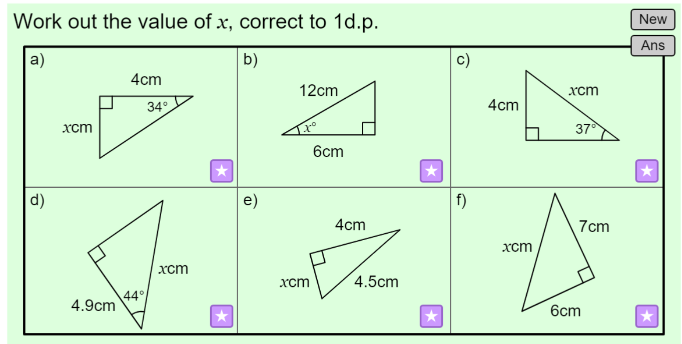


Trigonometric Identities
How has Mathematics been used in GPS?

Slide 2

Trigonometrical Identities and Equations
10.2 & 10.3 TBAT find exact values for some trigonometric ratios and work with trig identities
O
A
O
You need to be able to use the Trigonometrical identities
You should remember the ‘SOHCAHTOA’ rule from GCSE Maths.
S
H
C
H
T
A
Replacing these in the original Equation…
How has Mathematics been used in GPS?
Cancel the H’s

Slide 3
Trigonometrical Identities and Equations
10.2 & 10.3 TBAT find exact values for some trigonometric ratios and work with trig identities
O
A
O
You need to be able to use the Trigonometrical identities
You do not need to be able to prove either of these Identities, but it is useful to see where they come from.
You should remember the ‘SOHCAHTOA’ rule from GCSE Maths.
You should also remember Pythagoras’ Theorem
S
H
C
H
T
A
Hyp
1
Opp
θ
Adj
Replace a, b and c
How has Mathematics been used in GPS?
This is how it is written

Slide 4
Trigonometrical Identities and Equations
10.2 & 10.3 TBAT find exact values for some trigonometric ratios and work with trig identities
You need to be able to use the Trigonometrical identities
How has Mathematics been used in GPS?
The Identities are unchanged if there is a value in front of θ.

Slide 5
Trigonometrical Identities and Equations
10.2 & 10.3 TBAT find exact values for some trigonometric ratios and work with trig identities
You need to be able to use the Trigonometrical identities
You will need to spend a lot of time on this topic, and develop your own understanding of how to manipulate these Identities
Example Question
Simplify the following Expression:
The value in front of θ does not affect the identity
How has Mathematics been used in GPS?

Slide 6
Trigonometrical Identities and Equations
10.2 & 10.3 TBAT find exact values for some trigonometric ratios and work with trig identities
You need to be able to use the Trigonometrical identities
You will need to spend a lot of time on this topic, and develop your own understanding of how to manipulate these Identities
Example Question
Simplify the following Expression:
Subtract Sin²θ
How has Mathematics been used in GPS?

Slide 7
Trigonometrical Identities and Equations
10.2 & 10.3 TBAT find exact values for some trigonometric ratios and work with trig identities
You need to be able to use the Trigonometrical identities
You will need to spend a lot of time on this topic, and develop your own understanding of how to manipulate these Identities
Example Question
Simplify the following Expression:
Replace the bottom using the 2nd Identity
Square root the bottom
Looks a bit like the first Identity?
How has Mathematics been used in GPS?

Slide 8
Trigonometrical Identities and Equations
10.2 & 10.3 TBAT find exact values for some trigonometric ratios and work with trig identities
You need to be able to use the Trigonometrical identities
You will need to spend a lot of time on this topic, and develop your own understanding of how to manipulate these Identities
Example Question
Simplify the following Expression:
Expand like a Quadratic
How has Mathematics been used in GPS?

Slide 9
